Slide 1
EMS702UP Statistical Thinking and Applied Machine Learning
W1.2 Sets and Probability
Jun Chen

Slide 2

Sets - Terminologies
If we can identify a property which is common to several objects, it is often useful to group them together. Such a grouping is called a set.
Set: A collection of objects. For Example,
A = {the resistors produced in
a factory on a particular day}
B = {all odd numbers}
D = {on, off}
E = {0, 1, 2, 3, 4, 5, 6}
F = {3, 1, 2, 0, 4, 5, 6}
G = {1, 2, 3}
The elements of a set can be described in words if they cannot be listed or listed easily, such as A and B.
Two sets are equal if they contain exactly the same elements, such as E and F.
Finite Set: A set with a finite number of elements, such as A, D, E, F.
Infinite Set: Otherwise, such as B.
Subset: A set contained completely within another set, such as $G⊆E=F$.
$∈\left(∉\right)$: An element is (is not) a member of a set, e.g. $4∈E$ but $4∉G$.
Universal Set $S$: the set containing all the objects of interest in a particular situation, e.g. $S=B$ if we are only interested in odd numbers.
Complement: The complement of G, denoted by $G^{’}$ contains all the elements of the universal set that are not in G, e.g. if $S=F$, then $G^{’}=\{0, 4, 5, 6\}$ .
Empty Set $φ$: A set that contains no members, e.g. if $S=F$, then $F^{’}=φ$.

Slide 3
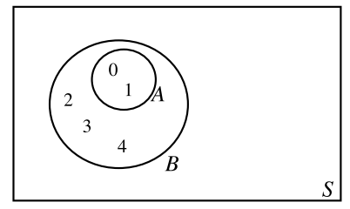
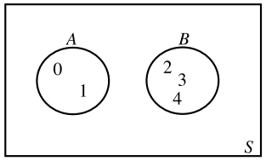
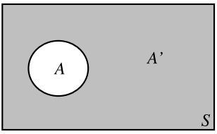
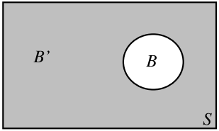
Sets - Venn Diagrams

Slide 4
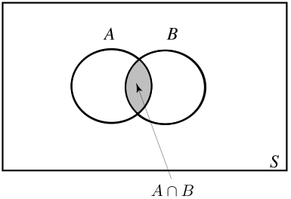
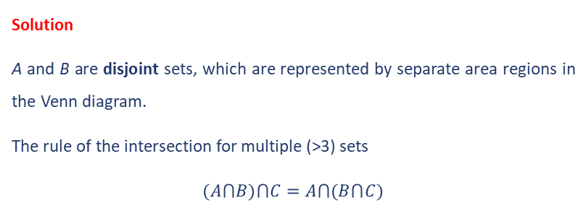
Sets – The Intersection of Sets
Intersection of Sets: A⋂B=B⋂A={x:x∈A and x∈B}.
Example 1
From the Venn diagram below, state A⋂B
Solution
A and B are disjoint sets, which are represented by separate area regions in the Venn diagram.
The rule of the intersection for multiple (>3) sets
$$(A⋂B)⋂C=A⋂(B⋂C)$$

Slide 5
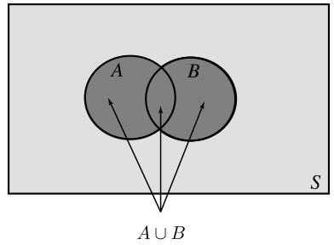
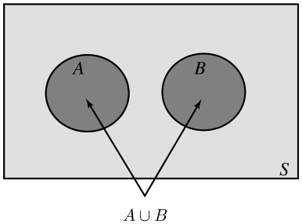
Sets – The Union of Sets
The Union of Sets: $A⋃B=B⋃A=\{x:x∈A or x∈B\}$.
Example 2
From the Venn diagram below, state A⋃B
Solution
There is no need to repeat elements in a set.

Slide 6
Elementary Probability
Probability is about the study of uncertainty and provides us the tools to set up mathematical models of systems and processes which are affected by random occurrences or ‘chance’.
There are many sources of randomness in applied machine learning. Sources of randomness in machine learning include
Randomness in Data
Randomness in Algorithms
Randomness in Evaluation
Therefore, we must find a way to keep randomness under control, so as to limit its impact of e.g. noise in the data, to evaluate model skills, and to improve algorithms. Probability theory lay down a foundation for machine learning practitioners to do this.

Slide 7
Elementary Probability – Recap Terminologies
Example 3
Obtain the sample space of the experiment throwing a single coin.
Solution We list the outcomes as a set {H, T} – the order being unimportant. {H, T} is the sample space.
In this particular case, the order of the outcomes is unimportant like for sets in general. Heads or Tails are equally likely to occur. Therefore, for a fair coin, H and T are equally likely outcomes.
The sample space obtained in Example 3 is an equi-probable space as the chance that any one sample point in it occurs is equal to the chance that any other sample points occurs.
Discrete Sample Space: The sample space in the form of a list (possibly infinite) like in Example 3.
Continuous Sample Space: The sample space that is not possible to list.

Slide 8
Elementary Probability – Recap Terminologies
Example 4
Obtain the sample space of the experiment measuring the tensile strength of small gauge steel wire.
Solution {Suitable continuous range (0-> ) depending on the wire}.
Example 5
Two fair coins are thrown. List the ordered outcomes for the event when just one Tail is obtained.
Solution We list the ordered outcomes as sets {H, T} and {T, H}. Here the order does matter unlike for sets in general. The event is a subset of the sample space. Unlike sets, events can be ordered when it is explicitly stated or within a certain context.
Complementary Event: The set of outcomes which are not members of the event from the sample space.
Example 6
Obtain the complement of the event in Example 5.
Solution {H, H} and {T, T}

Slide 9
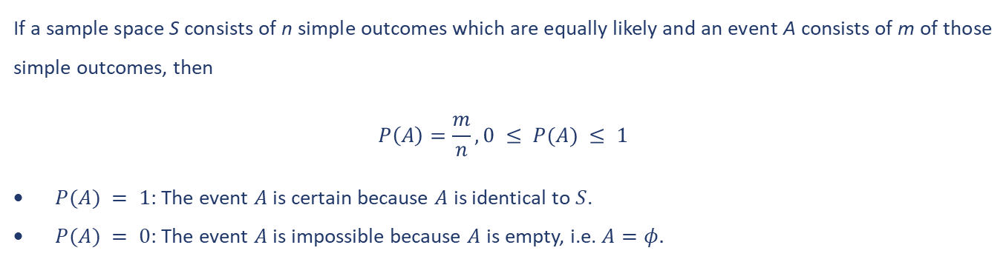

The Definition of Probability
The Principle of Equally Likely Outcomes enables us to deduce the probabilities that simple events (and hence more complicated events which are combinations of simple events) occur.
If a sample space S consists of n simple outcomes which are equally likely and an event A consists of m of those simple outcomes, then
$$P\left(A\right)=\frac{m}{n}, 0 ≤ P(A) ≤ 1$$
$P(A) = 1$: The event $A$ is certain because $A$ is identical to $S$.
$P(A) = 0$: The event $A$ is impossible because $A$ is empty, i.e. $A=φ.$
The Complement Rule: The probability of the complement of A occurring is equal to 1 minus the probability of A occurring.
$$P\left(A^{’}\right)= 1−P\left(A\right)$$

Slide 10
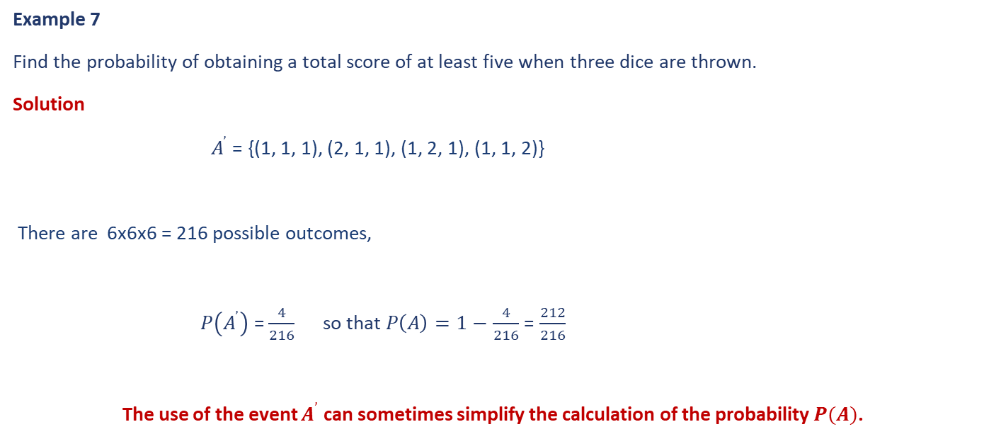
The Definition of Probability
Example 7
Find the probability of obtaining a total score of at least five when three dice are thrown.
Solution
$A^{’}$ = {(1, 1, 1), (2, 1, 1), (1, 2, 1), (1, 1, 2)}
There are 6x6x6 = 216 possible outcomes,
$P\left(A^{’}\right)$ = $\frac{4}{216}$ so that $P\left(A\right)=1−$ $\frac{4}{216}$ = $\frac{212}{216}$
The use of the event $A^{’}$ can sometimes simplify the calculation of the probability $P(A)$.

Slide 11
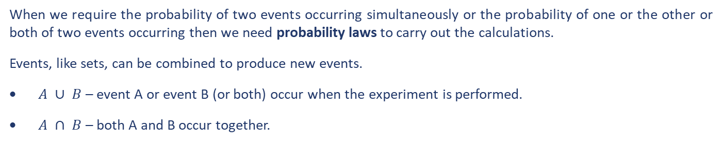
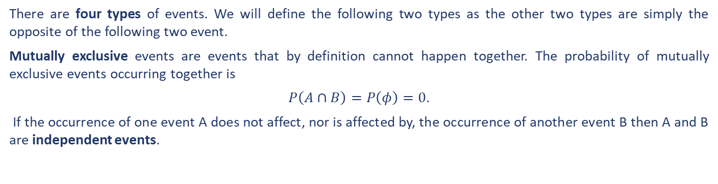
Laws of Elementary Probability
When we require the probability of two events occurring simultaneously or the probability of one or the other or both of two events occurring then we need probability laws to carry out the calculations.
Events, like sets, can be combined to produce new events.
$A ∪ B$ – event A or event B (or both) occur when the experiment is performed.
$A ∩ B$ – both A and B occur together.
There are four types of events. We will define the following two types as the other two types are simply the opposite of the following two event.
Mutually exclusive events are events that by definition cannot happen together. The probability of mutually exclusive events occurring together is
$P\left(A∩B\right)=P\left(φ\right)=0$.
If the occurrence of one event A does not affect, nor is affected by, the occurrence of another event B then A and B are independent events.

Slide 12
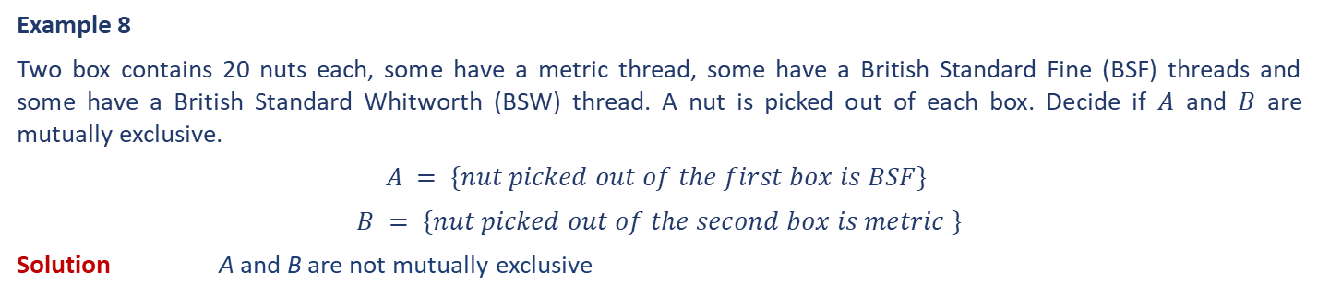
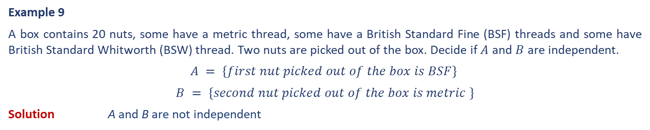
Laws of Elementary Probability
Example 8
Two box contains 20 nuts each, some have a metric thread, some have a British Standard Fine (BSF) threads and some have a British Standard Whitworth (BSW) thread. A nut is picked out of each box. Decide if $A$ and $B$ are mutually exclusive.
$$A = \{nut picked out of the first box is BSF\}$$
$$B = \{nut picked out of the second box is metric \}$$
Solution A and B are not mutually exclusive
Example 9
A box contains 20 nuts, some have a metric thread, some have a British Standard Fine (BSF) threads and some have British Standard Whitworth (BSW) thread. Two nuts are picked out of the box. Decide if $A$ and $B$ are independent.
$$A = \{first nut picked out of the box is BSF\}$$
$$B = \{second nut picked out of the box is metric \}$$
Solution A and B are not independent

Slide 13

Laws of Elementary Probability – The Addition Law
$P(A∪B)=P(A)+P(B)−P(A∩B)$.
$$P\left(A∪B∪C\right) = P\left(A\right)+P\left(B\right)+P\left(C\right)−P\left(A∩B\right)−P\left(A∩C\right)−P\left(B∩C\right)+P\left(A∩B∩C\right)$$
For a sample space $S$ consist of the $n$ simple distinct events $E1$, $E2$ $. . . En$, we have
$$P(E1) + P(E2) + · · · + P(En) = 1$$

Slide 14

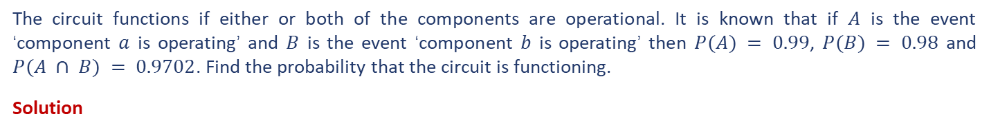
Laws of Elementary Probability – The Addition Law
Example 10
The diagram shows a simplified circuit in which two independent components a and b are connected in parallel.
The circuit functions if either or both of the components are operational. It is known that if $A$ is the event ‘component $a$ is operating’ and $B$ is the event ‘component $b$ is operating’ then $P(A) = 0.99$, $P(B) = 0.98$ and $P(A ∩ B) = 0.9702$. Find the probability that the circuit is functioning.
Solution
$$P\left(A∪B\right)=P\left(A\right)+P\left(B\right)−P\left(A∩B\right)=0.99+0.98−0.9702=0.9998$$
In this case, the probability that the circuit functions is greater than the probability that either of the individual components functions.

Slide 15


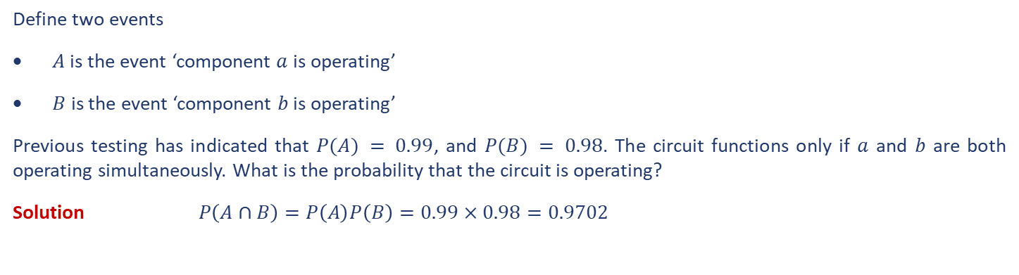
Laws of Elementary Probability – The Multiplication Law
The Multiplication Law of Two Independent Events:
$$P(A∩B)=P(A) P(B)$$
Example 11
Two components a and b are connected in series as shown below.
Define two events
$A$is the event ‘component $a$ is operating’
$B$ is the event ‘component $b$ is operating’
Previous testing has indicated that $P(A) = 0.99$, and $P(B) = 0.98$. The circuit functions only if $a$ and $b$ are both operating simultaneously. What is the probability that the circuit is operating?
Solution $P\left(A∩B\right)=P\left(A\right)P\left(B\right)=0.99×0.98=0.9702$

Slide 16

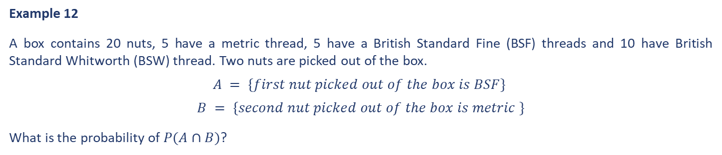
Laws of Elementary Probability – The Multiplication Law
What if the Event $A$ and $B$ are not independent? Let’s revisit Example 9.
Example 12
A box contains 20 nuts, 5 have a metric thread, 5 have a British Standard Fine (BSF) threads and 10 have British Standard Whitworth (BSW) thread. Two nuts are picked out of the box.
$$A = \{first nut picked out of the box is BSF\}$$
$$B = \{second nut picked out of the box is metric \}$$
What is the probability of $P(A∩B)$?
$$P\left(A\right)=\frac{5}{20}$$
$P\left(B\right)=\frac{5}{19} if first nut is BSF or BSW, and P\left(B\right)=\frac{4}{19}$ if first nut is metric
Solution
$P\left(B|A\right)=\frac{number of outcomes in A∩B}{number of outcomes in A}=\frac{P(A∩B)}{P(A)}=\frac{5}{19}→P(A∩B)$= $P\left(B|A\right)P\left(A\right)=\frac{5}{19}×\frac{5}{20}$
Where $P(B|A)$ is the conditional probability

Slide 17
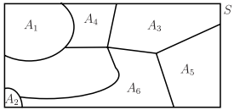
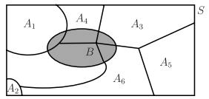
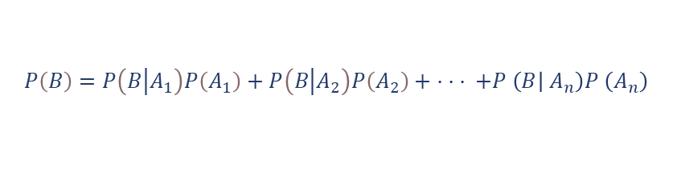
Total Probability Theorem
The Total Probability theorem enables us to calculate the probability of the event B, i.e. $P(B)$.
If $B$ is any event within $S$, then B can be expressed as the union of subsets:
$$B = \left(B ∩ A_{1}\right)∪\left(B∩A_{2}\right)∪· · · ∪\left(B∩A_{n}\right)$$
mutually exclusive events
$$P\left(B\right)= P\left(B∩A_{1}\right)+P\left(B∩A_{2}\right)+ · · · +P \left(B∩A_{n}\right)$$
Expressing the above equation in terms of conditional probabilities gives
$$P\left(B\right)=P\left(B\left|A_{1}\right.\right)P\left(A_{1}\right)+P\left(B\left|A_{2}\right.\right)P\left(A_{2}\right)+ · · · +P \left(B | A_{n}\right)P \left(A_{n}\right)$$

Slide 18
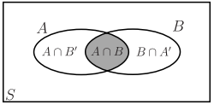
Total Probability Theorem
A special case of the Total Probability theorem considers $A$ to be an event in a sample space $S$ (the sample space is partitioned by $A$ and $A^{’}$) as shown below.
$$P\left(B\right)=P\left(A∩B\right)+P\left(B∩A^{’}\right)$$
With the conditional probability, $P(B)$ can be rewritten as
$$P\left(B\right)= P\left(B∩A\right)+P\left(B∩A^{’}\right)=P\left(B | A\right)P\left(A\right)+P\left(B | A^{’}\right)P\left(A^{’}\right)$$
It is easy to see that the probability of $P(B)$ in this special case is a simplified version of the theorem of Total Probability theorem.

Slide 19
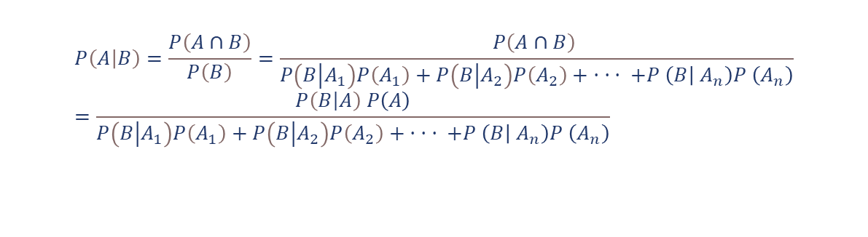
Bayes’ Theorem
The Bayes’ theorem enables us to calculate the probability of the event $A_{i}, i=1…n$, given the event $B$.
$$P\left(A | B\right)=\frac{P\left(A∩B\right)}{P\left(B\right)}=\frac{P\left(A∩B\right) }{P\left(B\left|A_{1}\right.\right)P\left(A_{1}\right)+P\left(B\left|A_{2}\right.\right)P\left(A_{2}\right)+ · · · +P \left(B | A_{n}\right)P \left(A_{n}\right)}=\frac{P\left(B\left|A\right.\right) P\left(A\right)}{P\left(B\left|A_{1}\right.\right)P\left(A_{1}\right)+P\left(B\left|A_{2}\right.\right)P\left(A_{2}\right)+ · · · +P \left(B | A_{n}\right)P \left(A_{n}\right)}$$
This is true for any event $A$ and so, replacing $A$ by $A_{1}$ gives the Bayes’ theorem.
$$P\left(A_{i} | B\right)=\frac{P\left(B\left|A_{i}\right.\right) P\left(A_{i}\right)}{P\left(B\left|A_{1}\right.\right)P\left(A_{1}\right)+P\left(B\left|A_{2}\right.\right)P\left(A_{2}\right)+ · · · +P \left(B | A_{n}\right)P \left(A_{n}\right)}$$

Slide 20
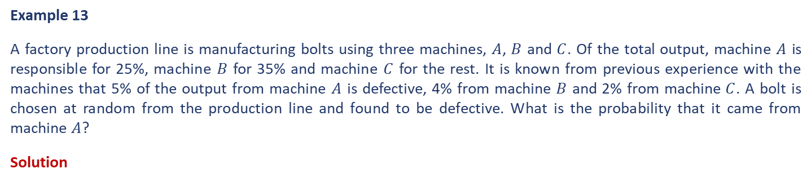
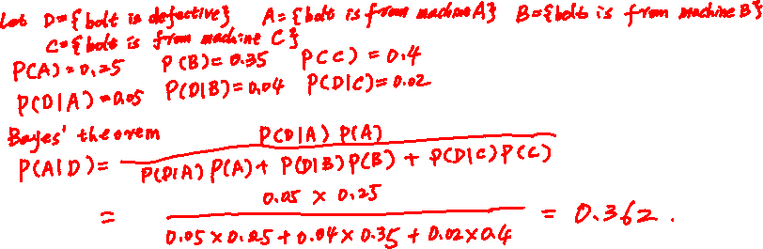
Bayes’ Theorem – An Example
Example 13
A factory production line is manufacturing bolts using three machines, $A$, $B$ and $C$. Of the total output, machine $A$ is responsible for 25%, machine $B$ for 35% and machine $C$ for the rest. It is known from previous experience with the machines that 5% of the output from machine $A$ is defective, 4% from machine $B$ and 2% from machine $C$. A bolt is chosen at random from the production line and found to be defective. What is the probability that it came from machine $A$?
Solution

Slide 21
Bayes’ Theorem – An Example
Example 13 – continued…
Solution

Slide 22
End slide

